Slide 1
T H E G U I D E B O O K
S H O R T M O V I E

Slide 3
- Personal Medicine
- Stationary
- Personal Laptop (optional)
- School Uniform as the dress code

Slide 4
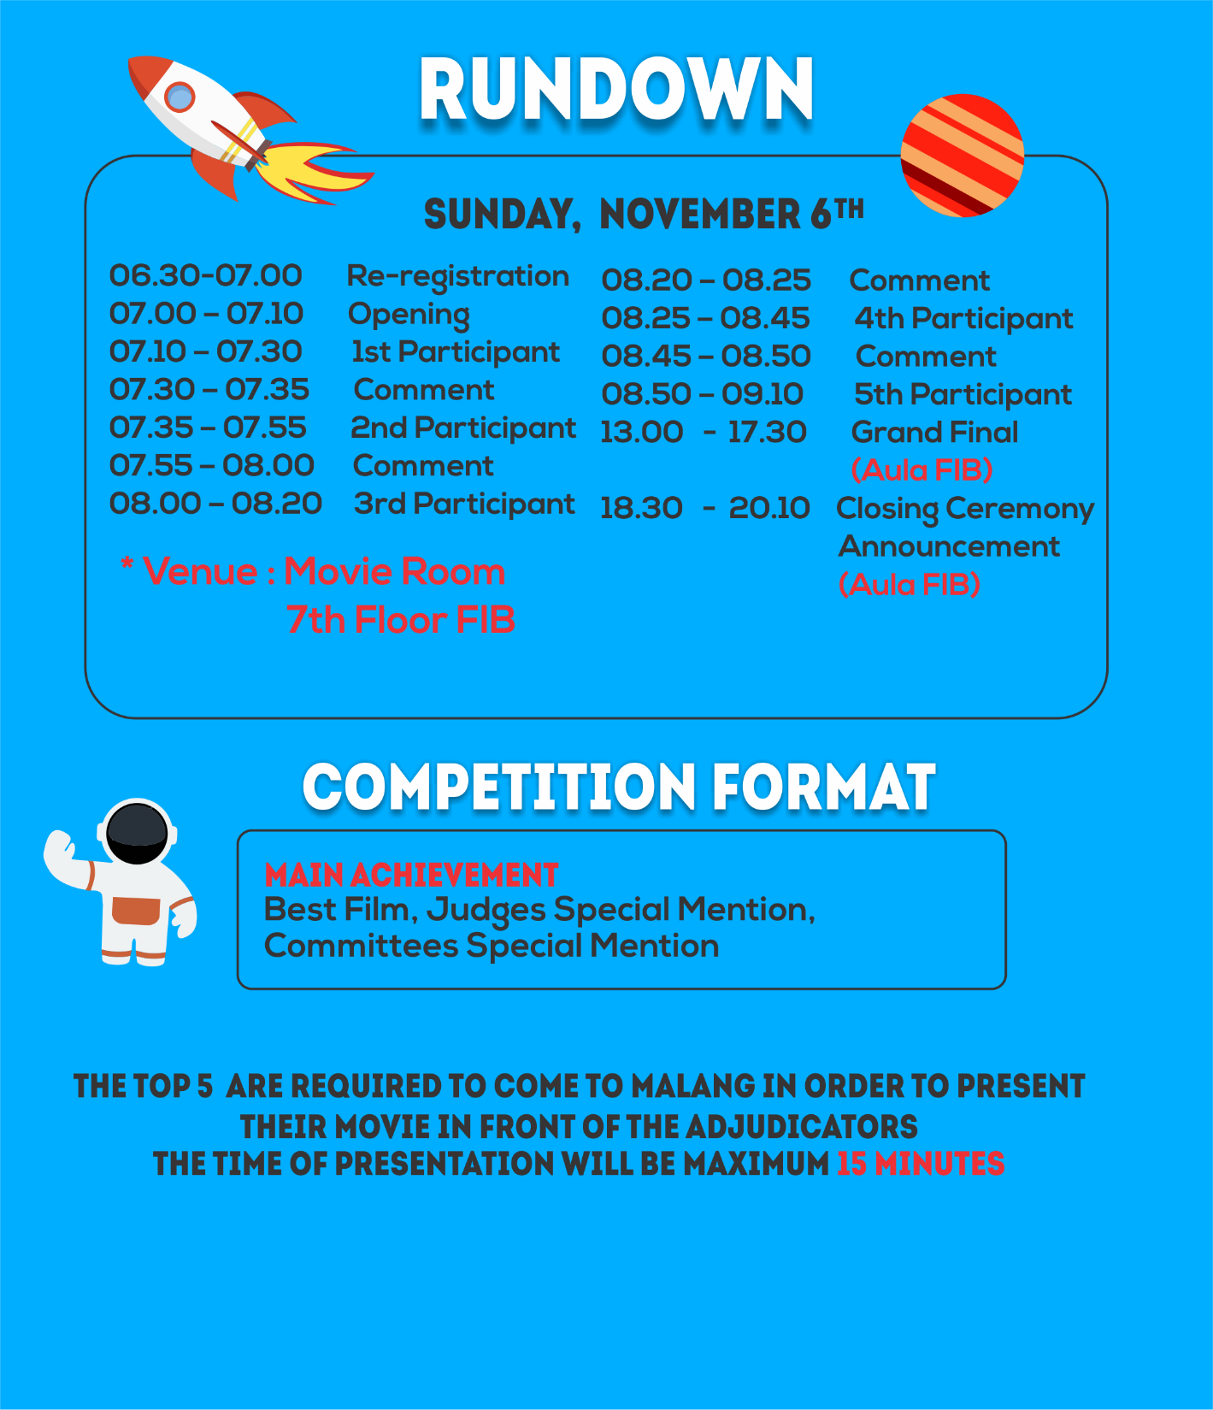

Slide 5
The Map

